Slide 1
Harvard Architecture based 8-bit Processor Design

Slide 2
Problem STATEMENT
Design an 8-bit processor (single core) with the following specifications:
32-numbers of 8-bit registers.
8-bit logic and unsigned fixed point arithmetic circuit.
Load and Store unit.
Data memory with 256 numbers of 8-bit locations.
32-bit Instructions.
Instruction memory with 64 numbers of 32-bit locations.
6-bit Program Counter.

Slide 3
Design approach
The ALU can be designed as follows.
1 Fixed Point Adder/Subtractor
Design 8-bit Carry Lookahead Adder circuit using KGP blocks and recursive doubling algorithm.
Now, use the same module for the design of subtractor with 2's complement.
2 Fixed Point Multiplier
Design the 8-bit Wallace Tree multiplier or Carry Save Array multiplier using carry-save-adders.
3 Fixed Point Divider
Design the 8-bit Non Restoring based Divider
4 Logical Left/Right Shifter
Design 8-bit Barrel or log logical left/right shifter.
5 Logic Unit
Design 8-bit Logic Unit to perform NOT, AND, OR, NAND, NOR, XOR, and XNOR operations.

Slide 4
Instruction Format and Encoding
Instruction Format
-> The design instruction should of 32-bit size.
-> The immediate and register move instructions will have the format as shown in Figure a, b respectively.
-> Similarly, the Load and Store instructions will have the format as shown in Figure c, d respectively.
-> The rest of the logic and arithmetic instructions will have the format as shown in Figure e.
Operation code Encoding
-> Encode the instruction opcode as shown in Table.

Slide 5
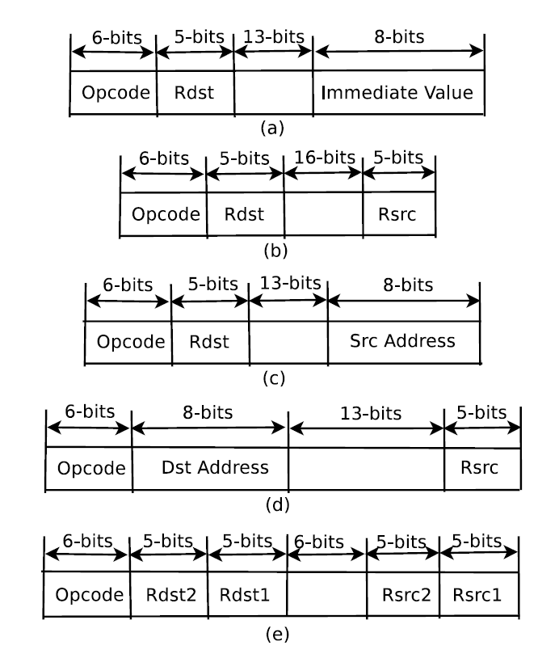

Slide 6
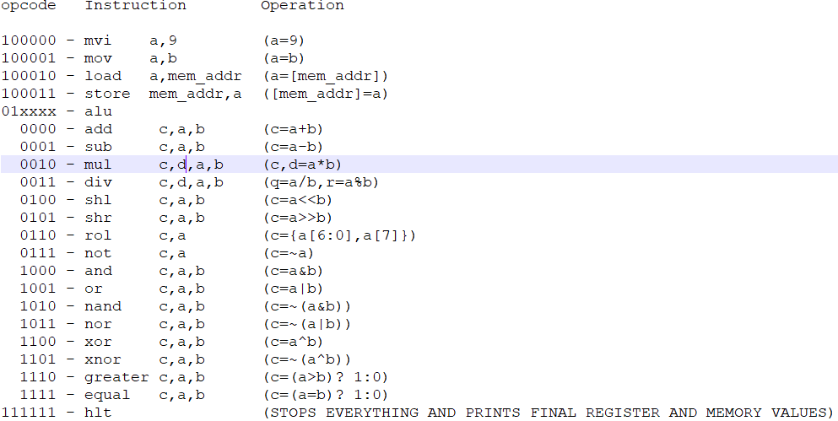

Slide 7
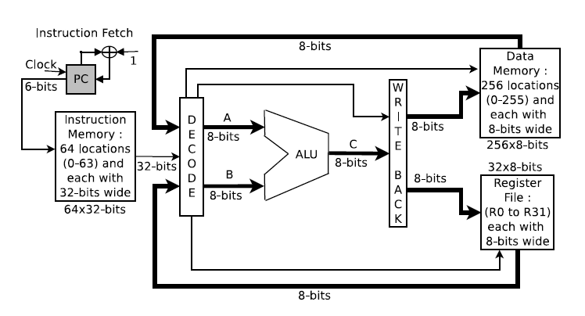
Processor architecture
The required processor architecture is shown in Figure, where the ALU includes all the logic and arithmetic functions units as mentioned above.

Slide 8
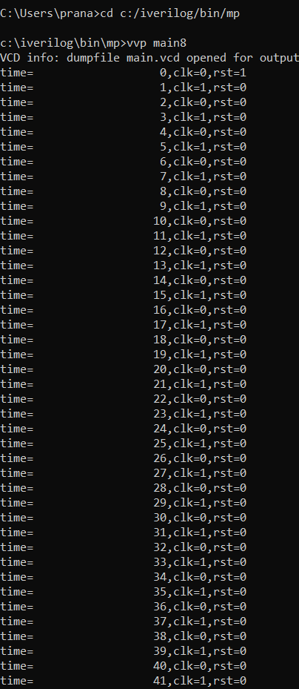
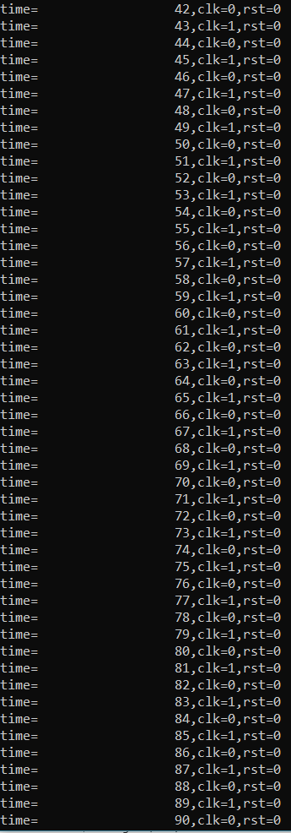
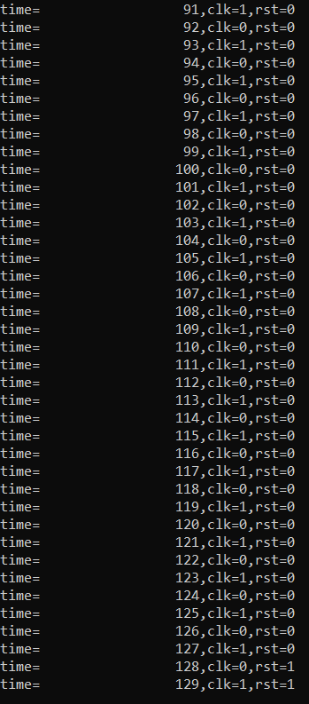
Execution result
After execution the updated register values and data memory values will be stored in reg_out.o and data_out.o

Slide 9
THANK YOU

